Slide 1
Topic 8: Search Interfaces
COMP3009J: Information Retrieval
Dr. David Lillis (david.lillis@ucd.ie)
UCD School of Computer Science Beijing Dublin International College

Slide 2
Search User Interfaces
The User Interface (UI) of any IR system has a role in helping the searcher to understand and express their information need, to help users formulate their queries, understand search results and keep track of their progress.
Studies mentioned here are referenced in Modern Information Retrieval book, Chapter 2.

Slide 3
How do people search?
Information Lookup: fact retrieval, question answering: satisfied by short pieces of information: numbers dates, names, URLs.
Standard Web search works well for this.
Exploratory Search: Users seeking information, and trying to learn about something, support planning, monitor an ongoing topic.
Likely a series of interconnected but diverse searches, and a changing information need (as more knowledge is acquired).

Slide 4
Dynamic Searching
The classic model of searching assumes the following process:
problem identification
articulation of information need
query formulation
results evaluation
But: this assumes that the information need is static.
If users learn as they search, they will acquire new information needs.

Slide 5
Observations of Behaviour
People often start with a general query, and then become more specific when they see the results, or they find a site that is worth exploring for more information, rather than running another search.
Users find it difficult to find whether a document is relevant or not! The less a user knows about a topic, the less able they are to judge whether a document is relevant.
Users assume that top-ranked documents are more relevant.

Slide 6
Observations of Behaviour
Users are often poor at estimating when they have found all relevant information: again generally when they have less knowledge of the topic.
Expert searchers use different strategies to novices.
Expert searchers tend to be more patient than novices and are willing to read more documents and spend more time on a task: more likely to find high-relevance documents.

Slide 7
Modern User Interfaces
Most queries are submitted as text.
Increase in voice search, which is likely to grow further.
Most common: short keyword searches: 1-3 words
Most search engines support syntax beyond this:
Boolean operators - (+, -)
Quotation marks for phrases - “information retrieval”
Specify one site - site:example.com
A study in 2006 found that only 1.1% of queries contain these and that only 8.7% of users ever used them.

Slide 8
Modern User Interfaces
The modern interface has two main functions:
To help the user enter queries that will return relevant results.
To help the user understand the results that are displayed.
Here are a number of examples, showing various UI strategies to help with these goals.

Slide 9

The Text Box
Most searches are entered in a simple text box.
The length of the text box is often carefully chosen:
Users are more likely to write long queries into bigger text boxes.
Users will be brief for small text boxes.

Slide 10
Multiple Text Boxes
yelp.com is a website for finding local businesses.
Here, we see multiple text boxes, to refine the search.
1. Box to say what I’m looking for
2. Box to say where I want it

Slide 11
Multiple Text Boxes
yelp.com is a website for finding local businesses.
Here, we see multiple text boxes, to refine the search.
3. Already contains examples,
to prompt the user
4. Automatically fills in
current location.

Slide 12
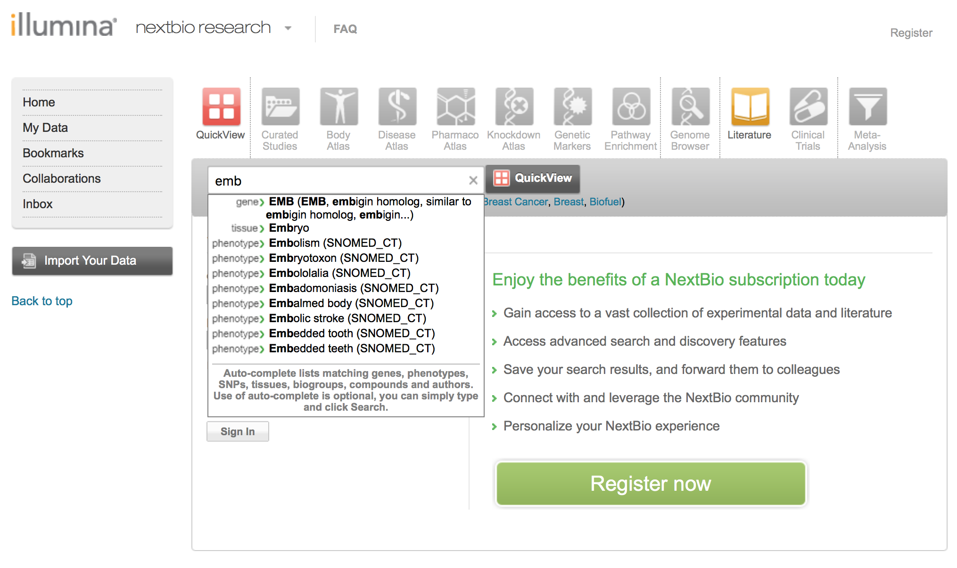
Query Suggestions
Start typing, and common searches will be suggested
This one has even grouped the suggested searches according to category.
A study done by Yahoo! showed
that users clicked on suggested
searches 33% of the time.

Slide 13
Query Suggestions
Query suggestions can be taken from many sources:
User’s own query history.
Popular searches.
List of product names (for a shopping site).
List of film names (for a movie site).
List of genes/diseases (for a medical site).

Slide 14
Results Display
Showing full documents is too long, so some kind of shorter representation is required.
The design of these representations is an area of active research and experimentation: how big should it be, what should it show, etc.?
Generally, title, URL, text summary and possibly other metadata is shown (e.g. publication date, author, etc.).

Slide 15
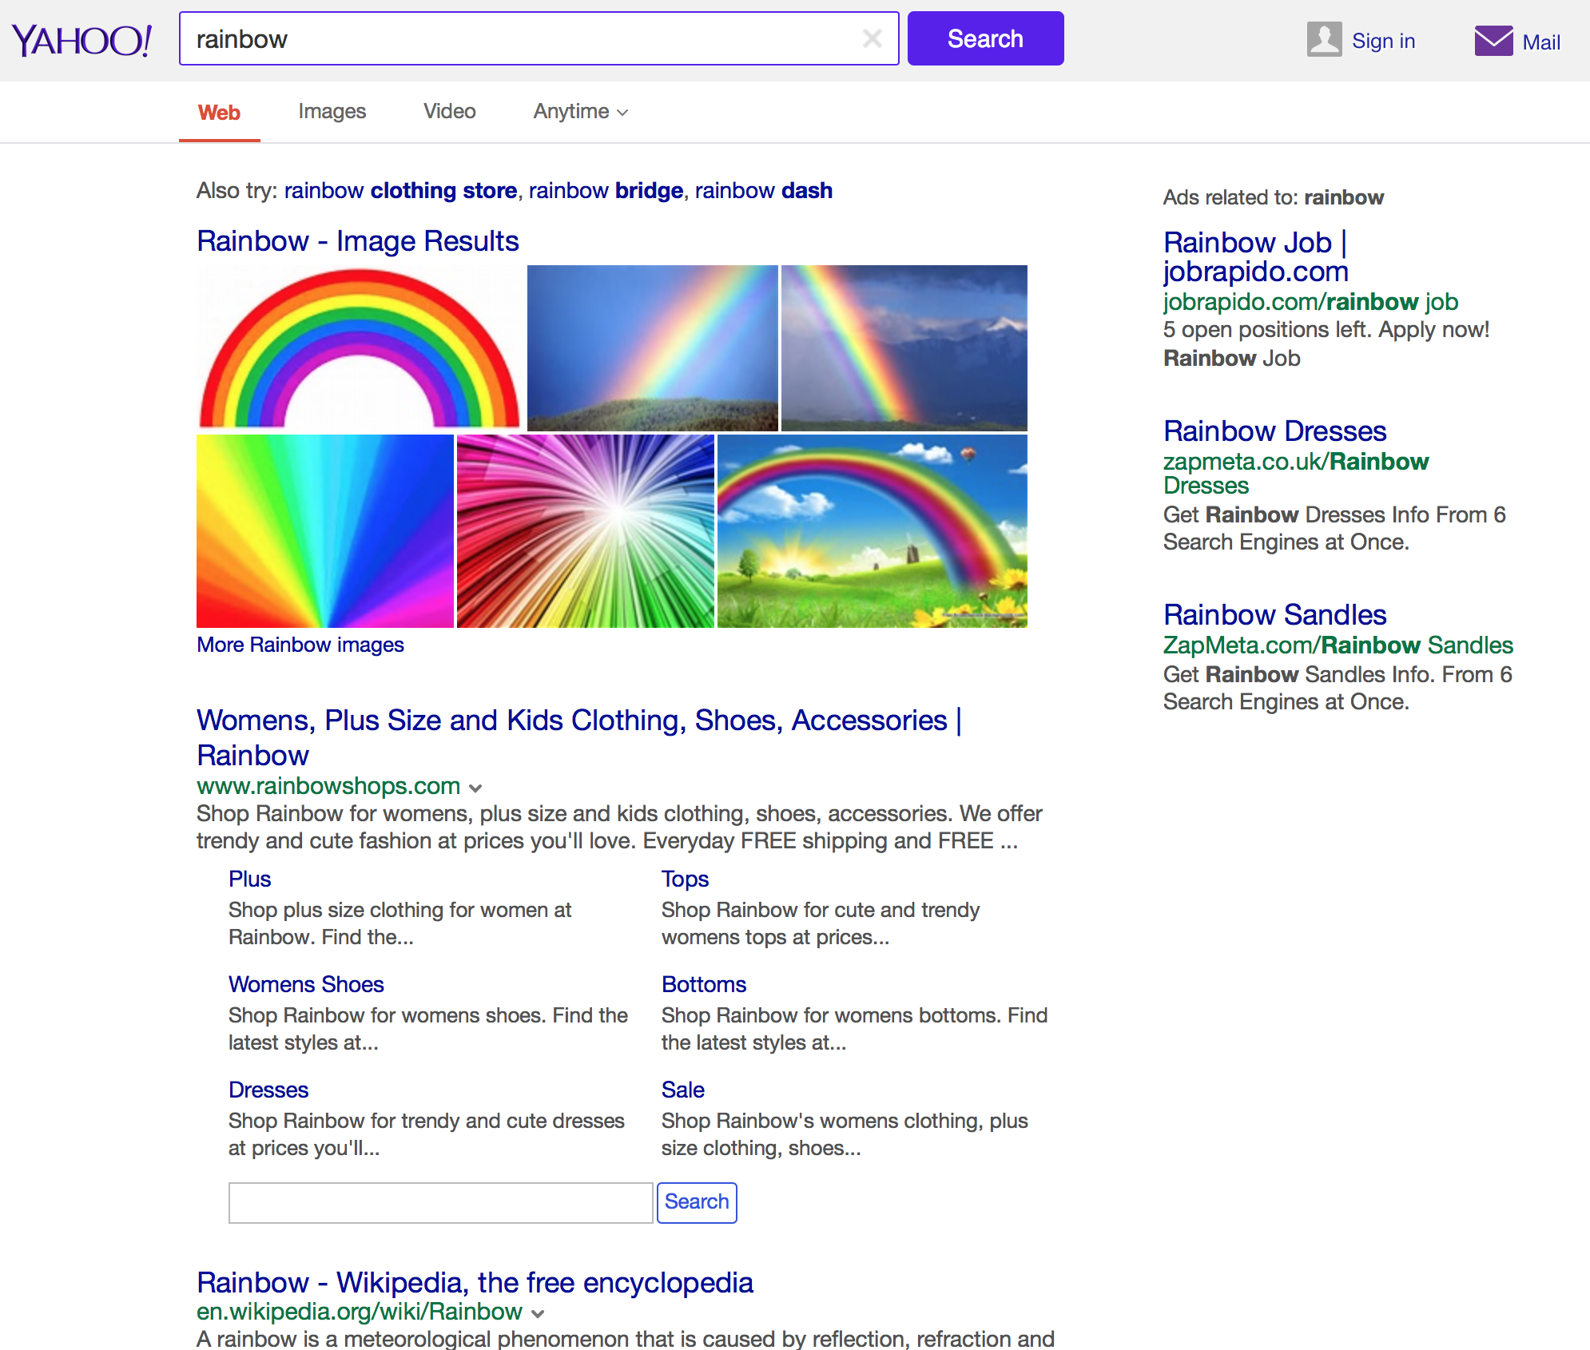
Title, URL, summary is standard.
First hit is a website homepage, so “deep links” to pages within the site can be shown, along with a separate search box to search within the site.

Slide 16
Also shows query refinement suggestions…
… and related adverts ...
… and related images.

Slide 17
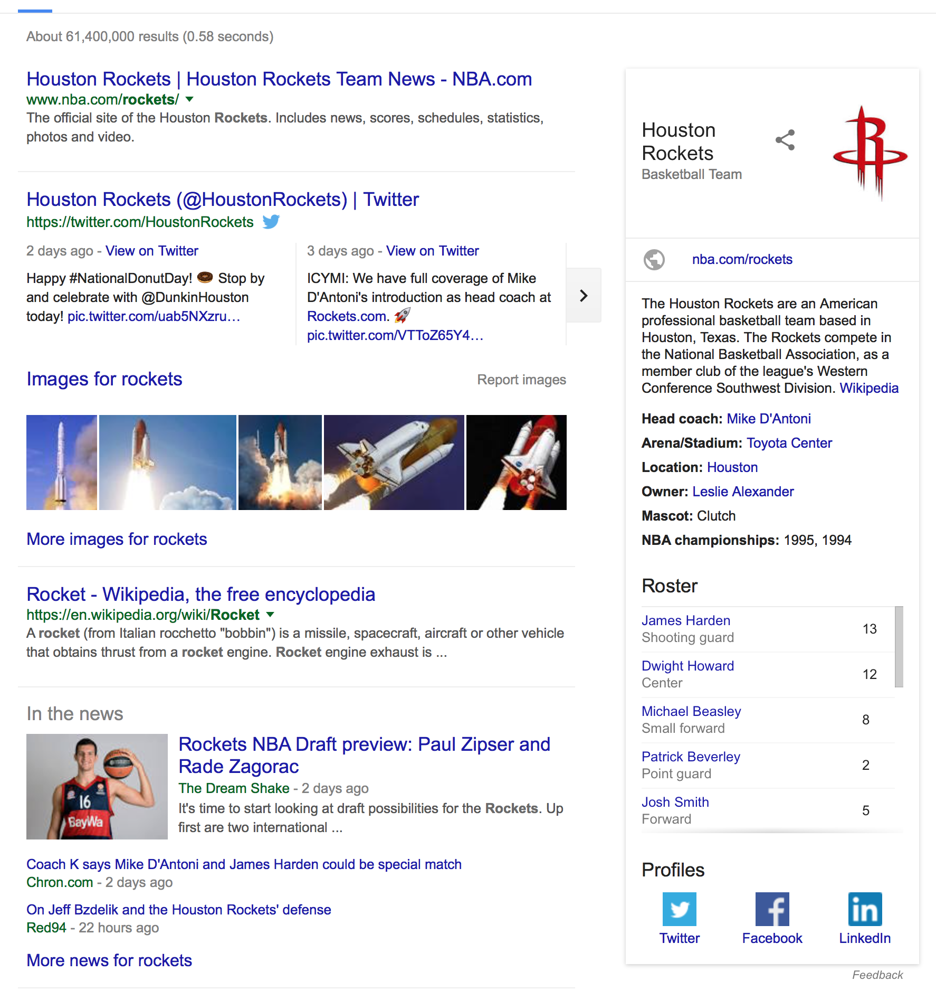
Google.com
Another example of “blended results” (or sometimes called “universal search”), where different types of results are combined together into the page the user sees.
This is for the query “rockets”.
News, images, the homepage of the Houston Rockets basketball team, and extracted information

Slide 18
Modern search interfaces can satisfy some information needs directly.
More of an “answer engine” than a “search engine”.
What sport do the Houston Rockets play?
Who is the head coach?
When did they last win the NBA championship?
Where do they play?

Slide 19
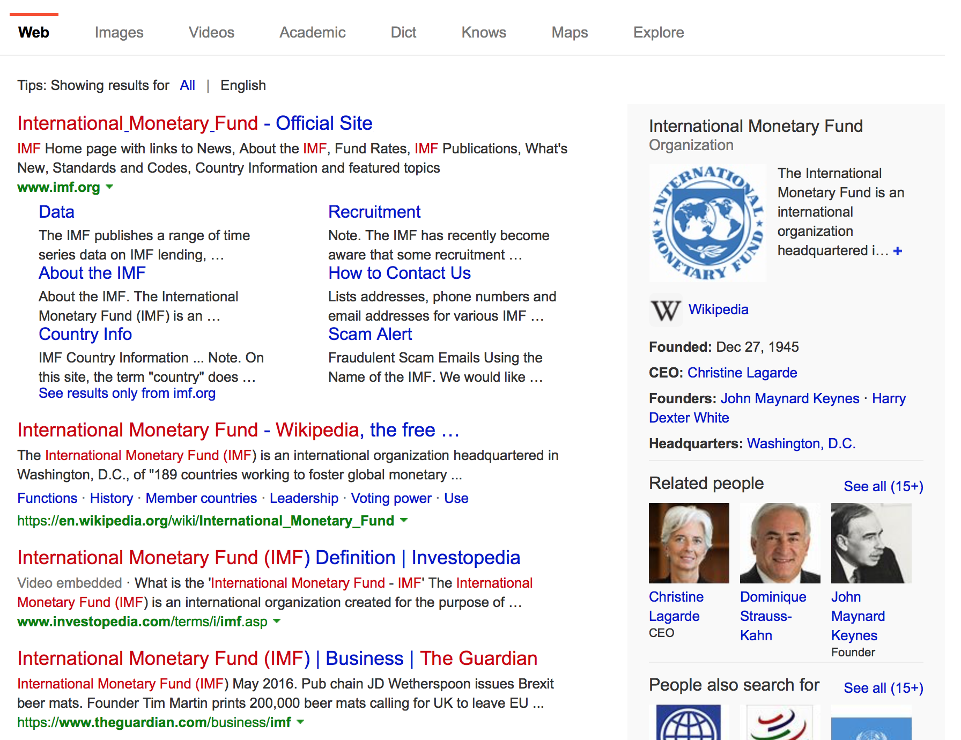
Bing.com: many similar features.
Highlighting of search term (here it’s “IMF”) helps users to find context.
How much text do we show?
What text do we show?
Some studies say it’s better to show full sentences, but these can be very long.
Difficult decision to make.

Slide 20
Results Display
Studies have shown that the amount of information to show depends on the type of information need.
A searcher looking for a homepage does not need long detailed information.
Requests for factual information can be satisfied by a short answer.
More complex information needs can be helped by longer summaries.
A study on scientific literature search showed that searchers liked having diagrams and tables from articles shown beside the search results.

Slide 21
Query Reformulation
After a user submits a query, they frequently modify it and run another search.
One study showed that 50% of searchers modified at least one query during a session.
Almost 1/3 modified three or more queries.

Slide 22
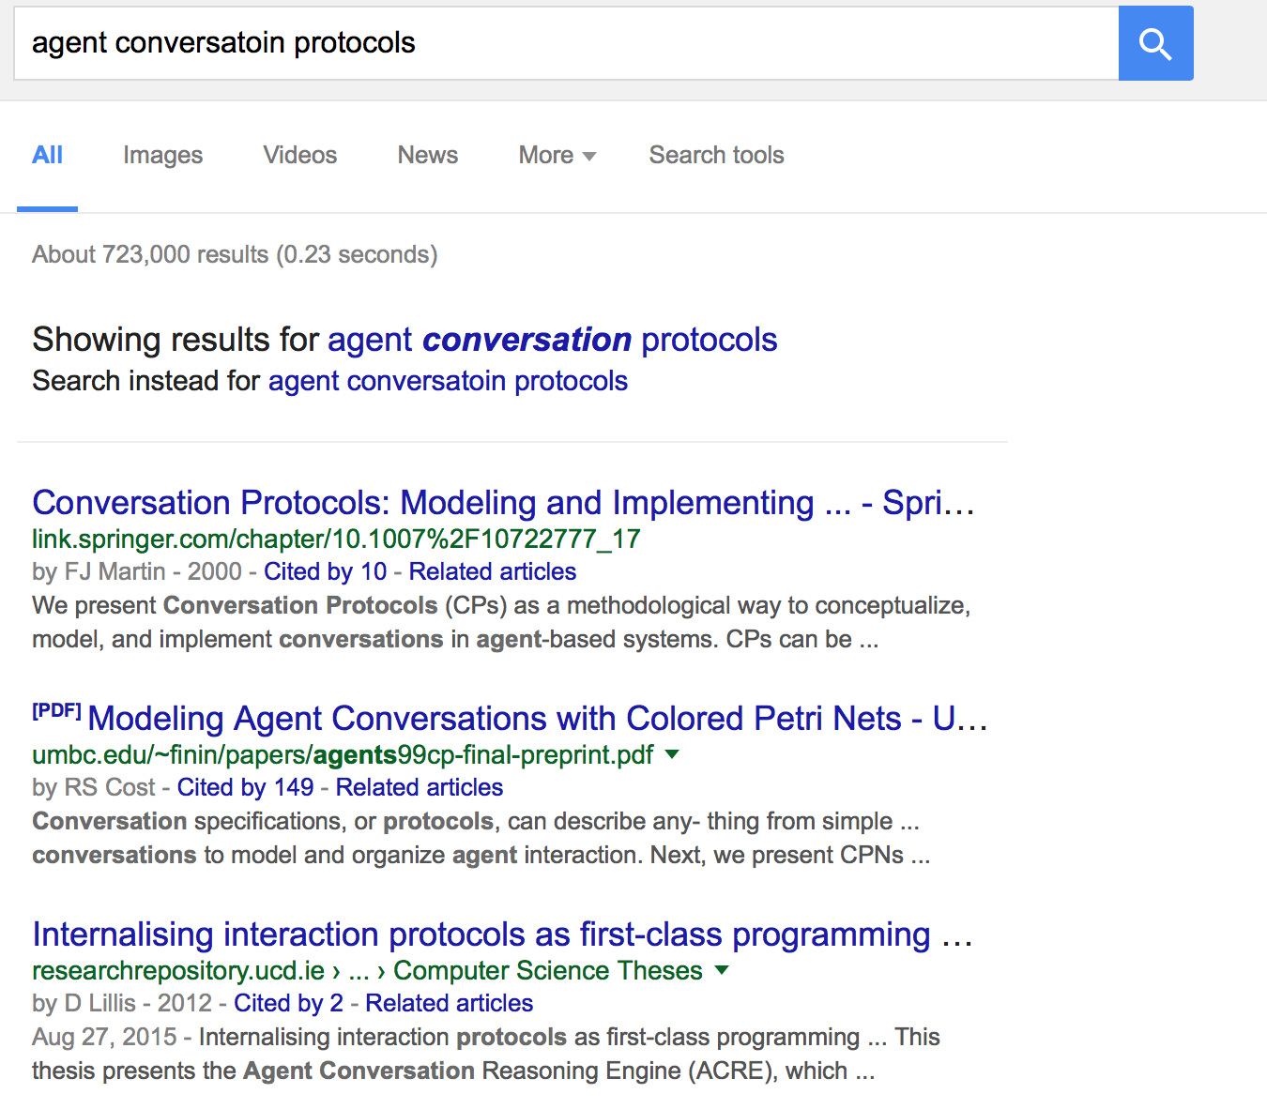
Query Reformulation: Spelling
Typographical errors/misspellings occur in 10%-15% of searches.
Traditionally dictionaries were used for correction.
Nowadays, use query log mining: look at how people have reformulated in the past, and compare with similar searches.

Slide 23
Query Reformulation: Other Approaches
Query Expansion: expand queries with similar terms. Originally automatic, but later moved to suggesting terms to users. Studies show that a small number of suggestions, requiring one click, can be useful.
Relevance Feedback: where a user indicates which documents are relevant. Not popular in modern search engines (partially because users are often poor at judging relevance, and partially because it is not always beneficial).
A variation on this is a “related documents” feature.

Slide 24
Organising Results
Some users find it useful to have results organised into meaningful groups to help understand results.
Two main implementations:
Faceted categories: Generally a set of categories created manually to reflect different aspects of a topic.
Clustering: Grouping items according to some measure of similarity. Fully automatic.

Slide 25
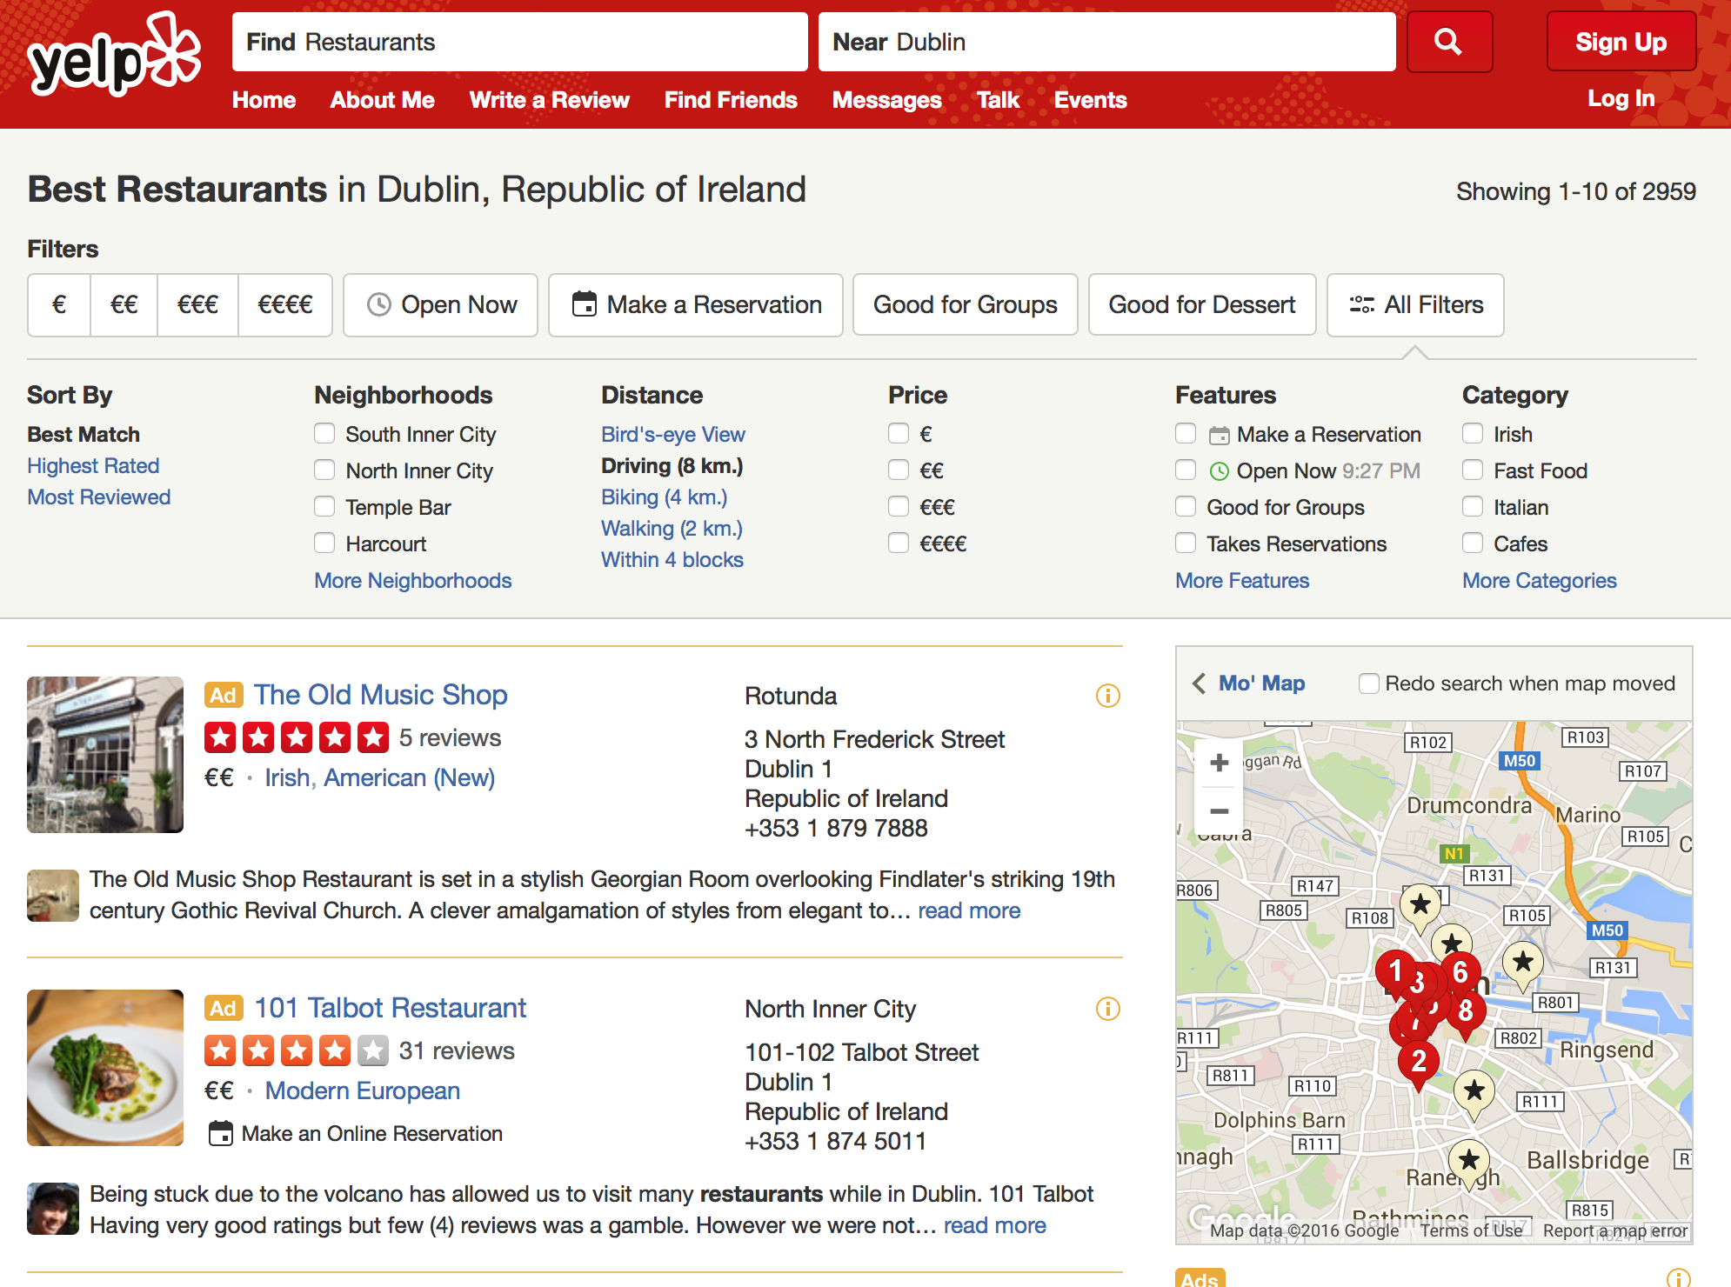
When searching for restaurants, we can search using different categories (distance, price, category, etc.)
Clicking on any facet value is, in effect, reformulating the query and running it again.
A restaurant can be tagged with different values within the same facet (e.g. if it’s within 2km it’s also within 4km)

Slide 26
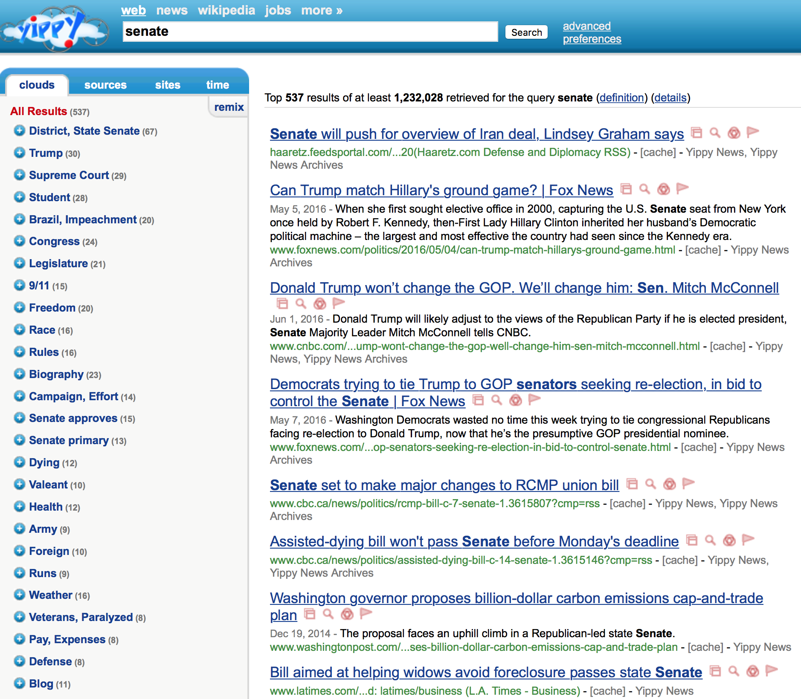
Clusters are automatically generated, and a keyword/phrase is extracted to describe each cluster.
Advantages: reveal interesting (and maybe unexpected) trends in document sets.
Help to group similar documents.
Topics do not need to be known in advance.
Disadvantages: Clusters are unpredictable, and may not make sense to human users.
There is often overlap between clusters in terms of their themes.

Slide 27
Summary
User Interfaces (UIs) have been subject to much study, so as to understand user behaviour and improve the UIs to help users create better queries, as well as to understand their results better.
Different UI strategies work best for different types of searcher: there is no one UI that has been shown to be better in all cases.
Much of the lessons learned in the IR community have not been learned in some other areas of UI design.

Slide 28
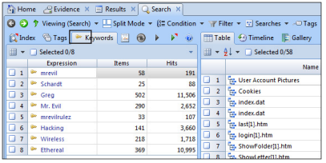
Search Interface for a Digital Forensics Investigation Tool (EnCase)

